Slide 1
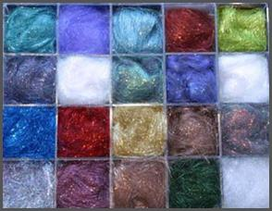
Synthetic fibers and plastics class VIII

Slide 2
Index
Fibres
Types of fibers
Plastic products
Raw materials for synthetic
Monomers and polymers
Polymerization
Polymers may be natural or synthetic

Slide 3
Index
Synthetic Fibres
Rayon
Plastics
Types of plastics
Nylon
Polyester
Acrylic
Lycra or Spandex
Plastics and there uses

Slide 4
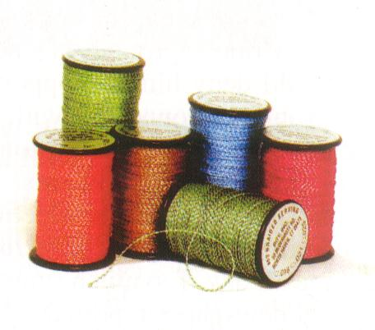
Fibres

Slide 5
Types of fibers
Natural fibers
Synthetic fibres

Slide 6
Natural and synthetic
Natural fibers come from natural sources like plants and animals.
Synthetic fibres are man-made fibres. Synthetic fibres are made from different chemicals, hence each kind of synthetic fibres have their own properties. Synthetic fibres are more in length and are long lasting. The only limitation in synthetic fibres is that they are poor absorbents of moisture and they catch fire easily

Slide 7
Monomers And Polymers
Substances are made of very small PARTICLES.
A single unit which makes a large molecule by the repeated combination of small unit is called as Monomer
A Polymer is a large molecule made up of a combination of a large number of small repeated units. This large molecule is called as Polymer and large number of small repeated units is called as Polymer

Slide 8
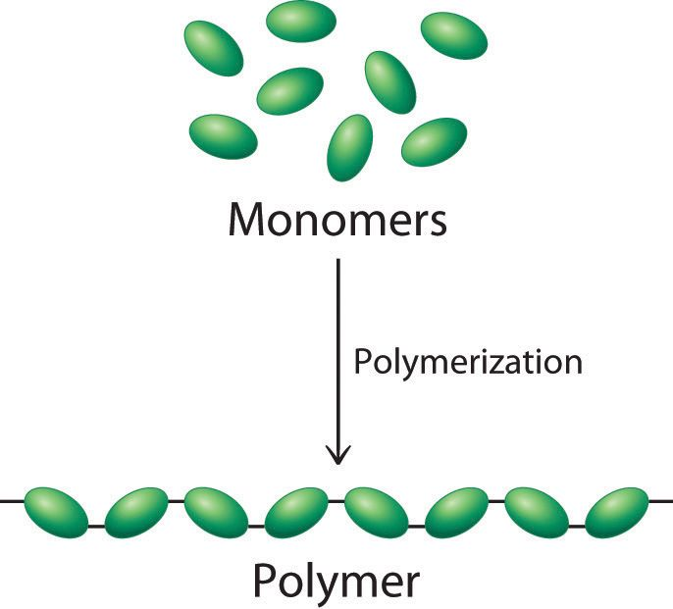
Polymerisation

Slide 9
Polymerisation
The reaction in which a many number of small repeating units ‘ monomer’ are joined together to form a large molecule ‘polymer’ under suitable conditions of temperature and pressure is called Polymerisation Reaction.

Slide 10
Polymers may be natural…….
Natural polymers:
Natural fibers like cotton, wool and silk are polymers.
Cotton is a polymer glucose.
Wool and silk are the polymers of amino-acid (protein).
Spider silk is one of the strongest natural polymers

Slide 11
Polymers can be synthetic
Synthetic polymers:
Synthetic polymers are made from chemical substances. They are plastic in nature .
Nylon and polyster are synthetic fibres
Example: Next slide

Slide 12
Polymers Example
Ethylene is a monomer obtained from petroleum. It’s chemical formula CH₂. During polymerization many units of ethylene gets linked to form a chain as follows:
This polymer is polyethylene, a kind of plastic- polythene
Some polymers are made of two or more units. Example : nylon which is made of amine and adipi cacid. Like this:
CH₂
CH₂
CH₂
CH₂
CH₂

Slide 13
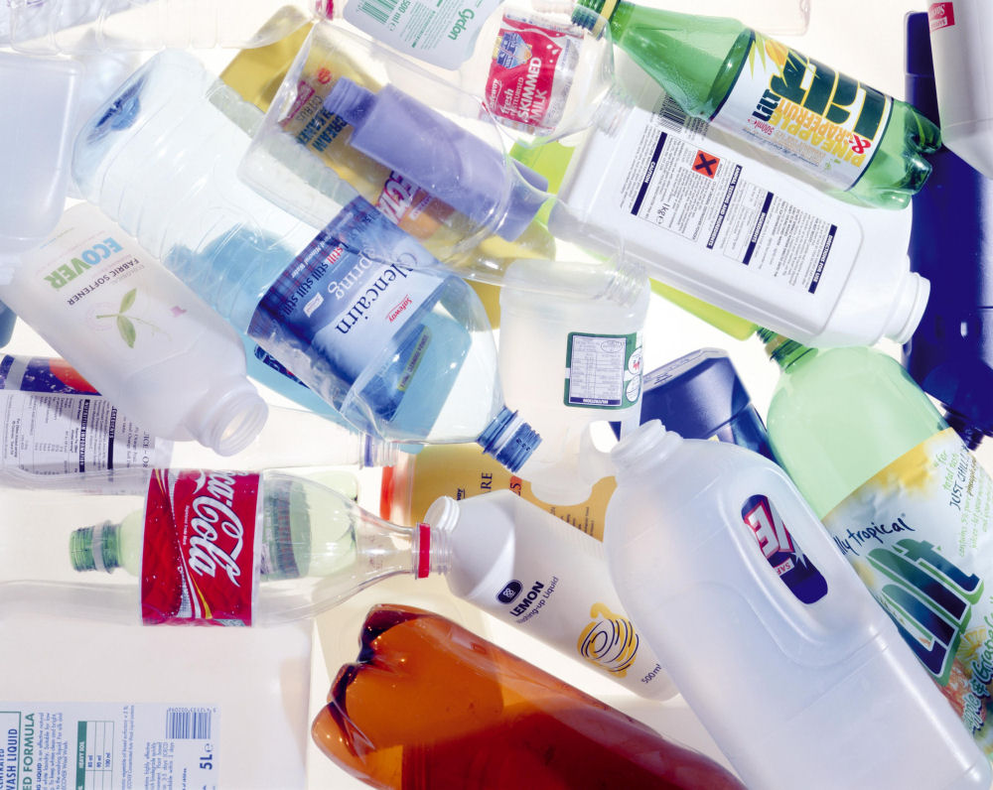
Plastic products

Slide 14
Raw materials for synthetics
Synthetic polymers :
Scientists evolved a mechanism to polymerize the monomers of certain substances like rubber, silicone and petroleum products such as ethane, propane, benzene, toluene, styrene, ester, and others.
All these are raw materials for synthetic plastics

Slide 15
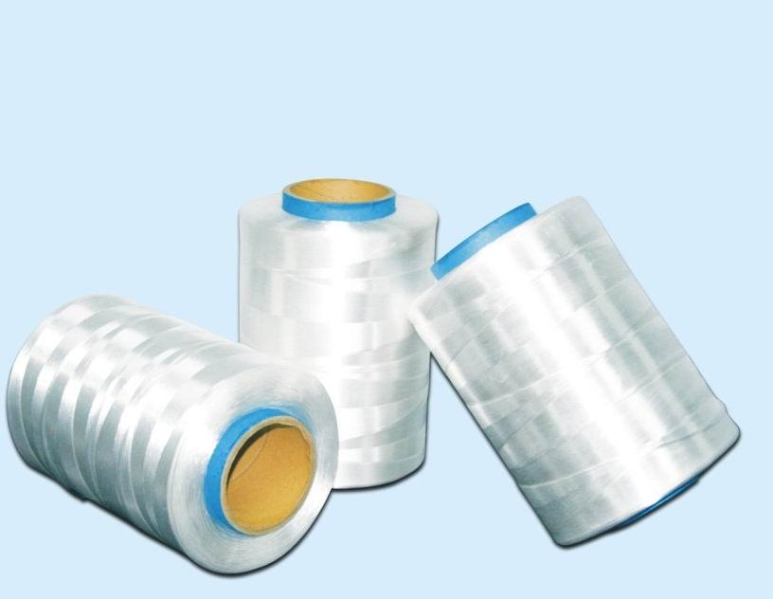
Synthetic Fibers

Slide 16
In the east, including India, cotton, wool and silk and in the west it was leather, wool and fur which were the first materials to be used for clothings. Other natural fibres were also being used in different parts of the country depending upon their availability.
It was towards the 1930s that synthetic fibre was developed.
Most synthetic fibres are obtained from petroleum products, natural gas and coal by the process of polymerization.

Slide 17
Rayon
Rayon is prepared from cellulose. Cellulose was converted into Rayon by using many chemicals and by following many steps. Though cellulose is a natural polymer it needs extensive chemical treatment to form rayon. Hence it is also considered as a semi-synthetic fibre. It is also called as ‘ Regenerated Fibre’
Advantage of rayon :
  it is cheaper to produce as compared to cotton itself since waste cotton and paper is used for making rayon.
  Secondly, rayon can be blended with other fibres like wool and silk.

Slide 18
Properties of rayon
drapes well
easily dyed and wooven into cloth
good absorbent of sweat
lustrous in appearance

Slide 19
Uses of rayon
Dress material because it is soft, silky and moisture absorbent
Curtains because it drapes well
Upholstery for luxury cars and officeand home furnishings
Reinforcing nylon tyres
Reinforcing nylon tyres
Reinforcing nylon tyres
Mixed with fibre glass for making helmets

Slide 20
Nylon
Nylon was first developed by American scientist, Wallace H. Carothers for M/S Dupont de Nemours & Company of America in 1935. Chemically it is a ‘polyamide’, a polymer. It is the strongest synthetic plastic material which can be moulded to any shape. Nylon has many uses as fibre, as sheet and as moulded solids. People believe that nylon has been named since its products were simultaneously launched in New York (NY) and London (LON).

Slide 21
Properties of nylon
toughest elastic material
high tensile strength
resists oil, grease, moths, fungus and other pests
It can be moulded into fibres, bristles, sheets, rods, tubes and coatings
can be made into palates or powdered
is lustrous and easy to wash
slightly water absorbent, dries quickly

Slide 22
Uses of nylon
Stretchable wears
Parachutes
Tracksuits
Making sarees
Thread
Reel thread
Mountaineering
ropes
Fishing nets and fishing lines
Upholstery
Seatbelts
Raincoats.
swimming wears

Slide 23
Polyester
Esters are compounds with fruity odour . Alcohol and organic acid react together to make compounds called esters which are polymers. These are therefore called polyesters.
If different alcohols and acids are used, different kinds of polyesters are made.
Polyesters come under the brand names of ‘Terylene’, ‘Dacron’, ‘Terene’ and ‘Polyester’. Polyester is blended with cotton and wool in different ratios to obtain polycot or terrycot (polyester cotton) and polywool or terrywool (polyester wool) which is easily maintainable.

Slide 24
Properties of polyester
Tough, light weight and elastic
Forms a permanent crease if heated and pressed
Easy to wash, does not shrink or stretch
Dries quickly
Resistant to pests and chemicals

Slide 25
Uses of polyester
Highly suitable for shirting, suiting, sarees and draperies
Mixed with fibre glass for moulding it into helmets, protective sheets and hulls in boats
Making magnetic audio and video cassattes and floppy disks.

Slide 26
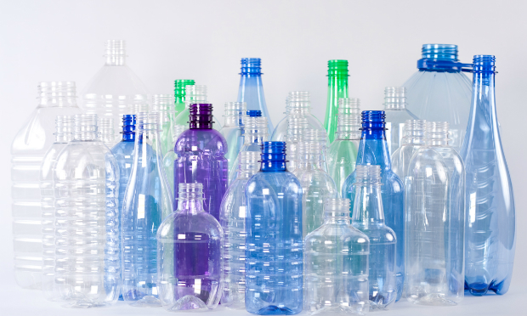
PET
PET is a very familiar form of
polyester. It is used for making bottles, utensils, films, wires and many other useful products. PET means Polyethylene terephthalate

Slide 27
Acrylic
Acrylic fibre is commonly known by different trade names such as ‘Acrilan’, Orlon’, ‘Creslan’, and ‘Zefran’. It is a synthetic wool-like fibre with crimps

Slide 28
Properties of acrylic
Resistant to moths
Soft with crimps resembling wool
Is durable light and washable
Strong and stain resistant
Also available in sheets
Can be dyed in different colors

Slide 29
Uses of acrylic
A transparent type of acrylic is used to cover automobile lights, lenses surgical tools etc
Used for making artificial fur, blankets, carpets etc.
Acrylic knitting wool is good for baby wears because they are soft, warm and washable.

Slide 30
Lycra or Spandex
It is fibre with great elasticity that stretches upto 600 times with the ability to return to its original shape intact. It is greatly used by stage performers who require cloths with snug fitting. It is greatly used in swimming suits, t-shirts and universal size caps in combination with cotton.

Slide 31
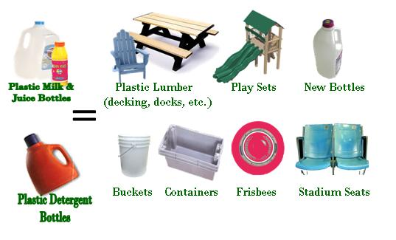
Plastics

Slide 32
There is a great variety of plastics made from different chemicals. Property and uses of each kind of plastic depend upon the material being used for its synthesis (polymerization)

Slide 33
Types of plastics
Thermosetting
Thermoplastics

Slide 34
Thermosetting plastics
Thermosetting plastics are hard and rigid. Example is Bakelite and melamine. Thermoset can be moulded to set it in any shape but it cannot be remoulded. It is dark in color, hard and resistant to heat and electricity. It is being widely used for the handle of kettles and pans. Earlier black telephone sets, electric switches, electric lamp holders, pins and plugs were made from thermoset plastic. It is also being used as a part of fibre glass sheet in the making of helmets. Melamine is a kind of Thermoset plastics used in good quality tableware. Melamine is also used as a coating on uniforms of firemen to make them fire resistant

Slide 35
Examples of therosetting plastics
Thermoset handles
A firemans uniform is coated with thermoset plastic to made it fire resistant
Melamine wares
An electric pin (black)

Slide 36
Thermoplastics
Thermoplastics are soft and flexib;e through they are not elastic like rubber and steel springs. They melt on warming and regain their shape on cooling. Thermoplastics can be drawn into fine fibers, moulded to any desired shape or stretched or spread as sheets. Some of the better known thermoplastics are nylon (polyamide), polyesters, polyethylene, polyvinyl chloride (PVC), acrylic, polyurethane, polypropylene (PP), poly-tetra-fluoro-ethylene (PTEE) etc

Slide 37
Thermoplastics examples
Plastic table and chairs
Plastic food containers
Plastic toys
Plastic spoons and forks
Plastic cups
Plastic daily use items

Slide 38
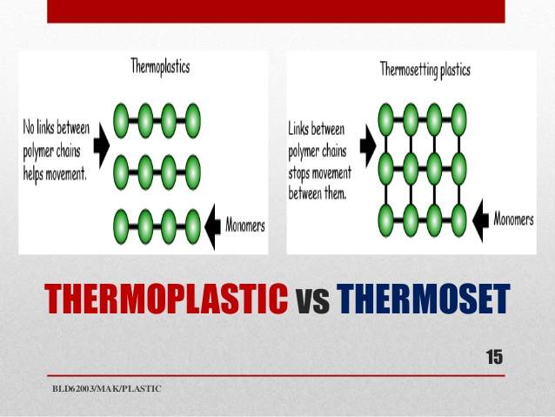

Slide 39
Advantages of synthetic Fibres
Strong and Durable
Light weight
Dyed in many colours
Easy to wash and wear
No requirement of ironing
Cheap
A substitute of natural fibre

Slide 40
Disdvantages of synthetic Fibres
Doesn’t absorb sweat so sticks to the body and makes the wearer uncomfortable
Melts before burning so sticks to the body
Accumulates charge on rubbing and sticks to the body
Non biodegradable

Slide 41


